Slide 1

Mini Symposiums
Recent Trends in Applied Sciences and Engineering
International Conference on Recent Developments in Mathematics.
Venue: Canadian University, Dubai.
Date: August 24-26, 2022.
Attainment Expedients of Markovian Heterogeneous Water Heaters in Queueing Models by Matrix Geometric Method
Dr. M. Seenivasan,
Associate Professor and Coordinator,
Mathematics Wing- DDE,
Annamalai University.
(AEECA-2022)
The 3RD IEEE International Conference on Advances in Electrical Engineering and Computer Applications
Venue: Dalian, China.
Date: August 19-20, 2022.

Slide 2
Attainment Expedients of Markovian Heterogeneous Water Heaters in Queueing Models by Matrix Geometric Method
Mathematics
Deterministic
Non-Deterministic
The solutions are determined to hold true with absolute certainty
The solution or outcome is a prediction with uncertainties that can be measured using chance or probability

Slide 3
Attainment Expedients of Markovian Heterogeneous Water Heaters in Queueing Models by Matrix Geometric Method
Deterministic:
  a sure event
  Every Sunday is a holiday.
Non-Deterministic:
  not a sure event
  Every Saturday may be holiday.

Slide 4
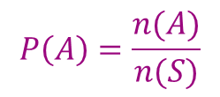
Attainment Expedients of Markovian Heterogeneous Water Heaters in Queueing Models by Matrix Geometric Method
Mathematical definition of Probability:
Let S be a sample space A be an event associated with a random experiment.
Let n(S) and n(A) be the number of elements of S and A.
The probability of event A occurring,
Where n(A) = Number of favourable to A
n(S) = Exhaustive number of cases in S.

Slide 5
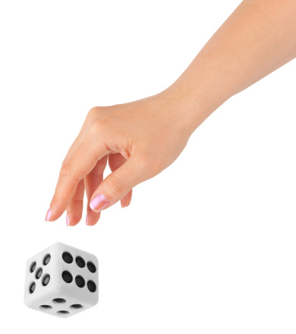
Attainment Expedients of Markovian Heterogeneous Water Heaters in Queueing Models by Matrix Geometric Method
For example,
The probability of getting an even number in the dice tossing experiment is 0.5,
as S={1, 2, 3, 4, 5, 6}, A={2, 4, 6},
n(S)=6 and n(A)=3.

Slide 6
Attainment Expedients of Markovian Heterogeneous Water Heaters in Queueing Models by Matrix Geometric Method
Axiom definition of Probability
Let S be a sample space and A be an event associated with a random experiment. The probability of the event A, is defined as a real number satisfying the following axioms
(i) 0 ≤ P(A) ≤ 1
(ii) P(S) = 1
(iii) If A and B mutually exclusive event,
P(AB)=P(A)+P(B)

Slide 7
Attainment Expedients of Markovian Heterogeneous Water Heaters in Queueing Models by Matrix Geometric Method
GENERATING FUNCTION
Let a₀,a₁,a₂, … be a sequence of real numbers. Using a variable s,
A(s)= a₀+a₁s+a₂s²+ …=

Slide 8
Attainment Expedients of Markovian Heterogeneous Water Heaters in Queueing Models by Matrix Geometric Method
PROBABILITY GENERATING FUNCTION
X is a random variable that assumes non-negative integral value 0,1,2, …,
P{X=k}=p_{k}, k=0,1,2, …,
a_{k} to be the probability p_{k}, k=0,1,2,… then
the corresponding function
of the sequence of probabilities {p_{k}} is known as the probability generating
function (p.g.f) of the random variable X.
The s-transform(or geometric transform) of the r.v X.

Slide 9
Attainment Expedients of Markovian Heterogeneous Water Heaters in Queueing Models by Matrix Geometric Method
P(1)=1; the series P(s) converges absolutely and
uniformly in the interval -1≤s≤1 and is infinitely
differentiable. The function P(s) is defined by {p_{k}}.
E(s^{x}) is the probability of the function s^{X} of the r.v x.
The first two derivative of P(s)

Slide 10
Attainment Expedients of Markovian Heterogeneous Water Heaters in Queueing Models by Matrix Geometric Method
The expectation E(X) is given by
Hence
If, as ∑k p_{k} diverges then E(X)=p'(1) =∞

Slide 11
Attainment Expedients of Markovian Heterogeneous Water Heaters in Queueing Models by Matrix Geometric Method
If ∑k(k-1) p_{k} diverges then P"(1)=∞ and Var(X)=∞.
The mean and variance of X in term of the P.g.f. of X.
More generally , the k^{th} factorial moment of X is given by
E{X(X-1)…(X-k+1)}=d^{k}P(s)/ds^{k}|_{s=1} for k=1,2,…

Slide 12
Attainment Expedients of Markovian Heterogeneous Water Heaters in Queueing Models by Matrix Geometric Method
BERNOULLI DISTRIBUTION
Let X be random variable that assume only two values 0 and 1 with
P{X=1}=p, P{X=0}=q=1-p (0<p<1).
The p.g.f of the random variable X is
P(s)=E[s^{x}]=q+sp.
E(X)=p and var(X)=pq.
Independent trials with only two possible outcomes at each are known as Bernoulli trials.

Slide 13
Attainment Expedients of Markovian Heterogeneous Water Heaters in Queueing Models by Matrix Geometric Method
BERNOULLI DISTRIBUTION CONT…..
Denoted
Success by 1 and
Failure by 0 and
Their probability by p and q respectively ;
We then get Bernoulli distribution and X is called a Bernoulli random variable with parameter p.

Slide 14
Attainment Expedients of Markovian Heterogeneous Water Heaters in Queueing Models by Matrix Geometric Method
BINOMIAL DISTRIBUTION
Let X be a random variable . Denoting the number of success (or failures) in a fixed number n of Bernoulli trials.
Then X has binomial distribution having p.m.f.
k=0,1,2…,n
Then p.g.f of X is
P(s)=(q+sp)^{n}
E(X)=np and var(X)=npq.

Slide 15
Attainment Expedients of Markovian Heterogeneous Water Heaters in Queueing Models by Matrix Geometric Method
POISSON DISTRIBUTION
Let X be a Poisson variant with p.m.f.
K=0,1,2,…
The p.g.f. of Poisson distribution is given by
=e^{{λ(s-1)}}.
E(X)=λ and Var(X)=λ.

Slide 16
Attainment Expedients of Markovian Heterogeneous Water Heaters in Queueing Models by Matrix Geometric Method
GEOMETRIC DISTRIBUTION
Let X be a r.v with geometric distribution {p_{k}},
P_{k}=p{x=k}=q^{k}p, k=0,1,2,…
The p.g.f of X is
We have
E(x) = p'(1)=q/p.
Var(x) = p"(1)+p'(1)-[p'(1)]²=q/p².

Slide 17
Attainment Expedients of Markovian Heterogeneous Water Heaters in Queueing Models
by Matrix Geometric Method
Discrete Random Variable:
If X is a random variable which can take a finite number or countable infinite number of values
For example, A simple experiment like throwing a true die.
Continuous Random variable:
If X is an random variable which can take all values in an interval
For example, The length of time during which a vacuum tube installed in a circuit functions.

Slide 18
Attainment Expedients of Markovian Heterogeneous Water Heaters in Queueing Models
by Matrix Geometric Method
Random Processes
Families of Random variables which are functions of time
Example:
A simple experiment like throwing a true die.
{X_{n} ; n≥1} is outcome of n throw.
A family of random variables such that for a distinct value of
n(=1, 2, . . . ), one gets a distinct random variable constitutes
a random process, Known as Bernoulli process.

Slide 19
Attainment Expedients of Markovian Heterogeneous Water Heaters in Queueing Models
by Matrix Geometric Method
Classifications of Random processes
Discrete time, discrete state space
Discrete time, continuous state space
Continuous time, discrete state space
Continuous time continuous state space

Slide 20
Attainment Expedients of Markovian Heterogeneous Water Heaters in Queueing Models
by Matrix Geometric Method
Queueing Theory
The analysis and description of real world phenomenon through probability theory leads to stochastic modelling. Queueing theory is one of the most important field in the stochastic modelling.

Slide 21

Attainment Expedients of Markovian Heterogeneous Water Heaters in Queueing Models
by Matrix Geometric Method
History of the Queueing Theory
The queueing theory has its origin in 1909, when
A.K. Erlang*(1878-1929) published his
fundamental paper relating to the study of
congestion in telephone traffic.

Slide 22
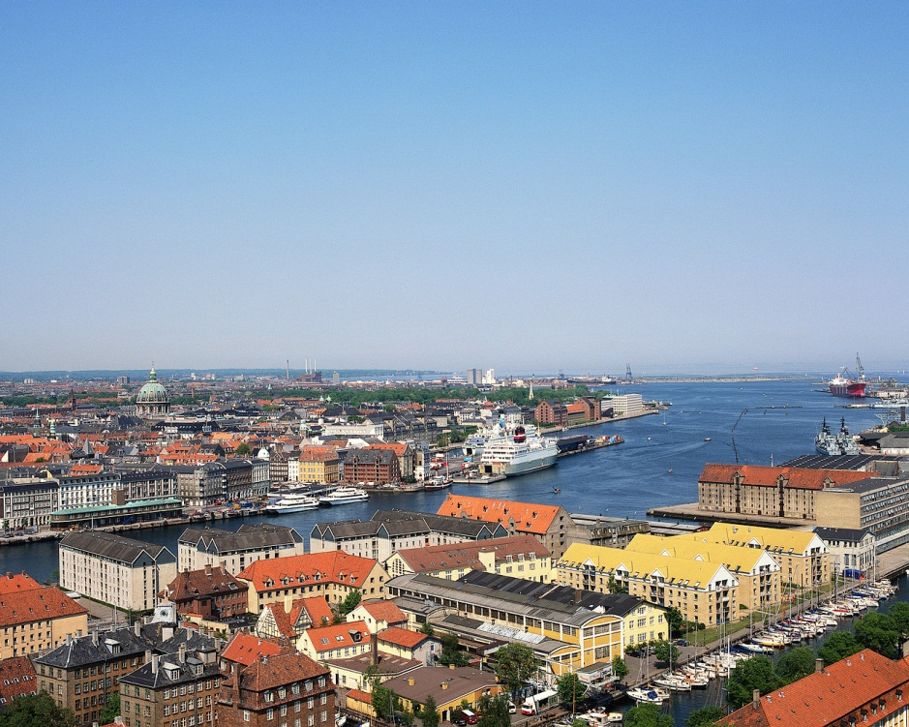
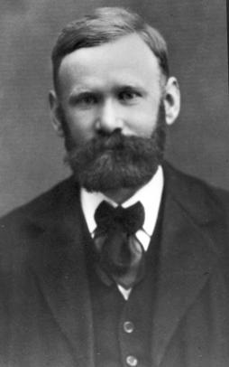
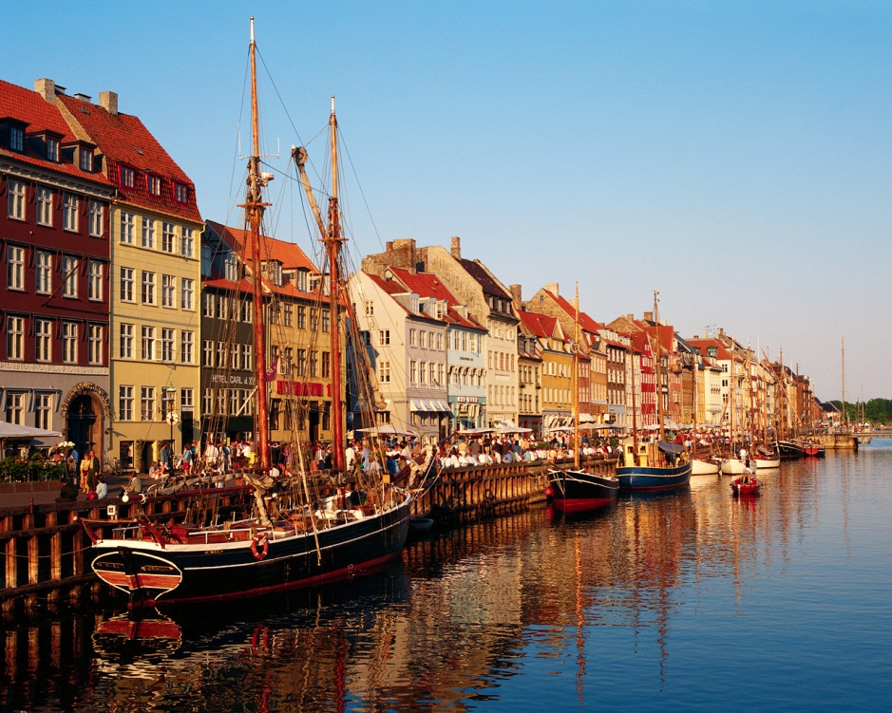
Attainment Expedients of Markovian Heterogeneous Water Heaters in Queueing Models
by Matrix Geometric Method
The Father of Queuing Theory
Danish engineer, who, in 1909
experimented with fluctuating
demand in telephone traffic in
Copenhagen.
In 1917, he published a report
addressing the delays in automatic
telephone dialing equipment
At the end of World War II, his work
was extended to more general
problems, including waiting lines
in business.
AGNER K. ERLANG

Slide 23
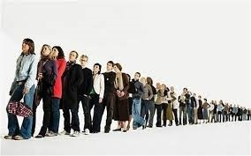
Attainment Expedients of Markovian Heterogeneous Water Heaters in Queueing Models
by Matrix Geometric Method
Queue
A queue is a waiting line which is usually formed Infront of some service facility.

Slide 24
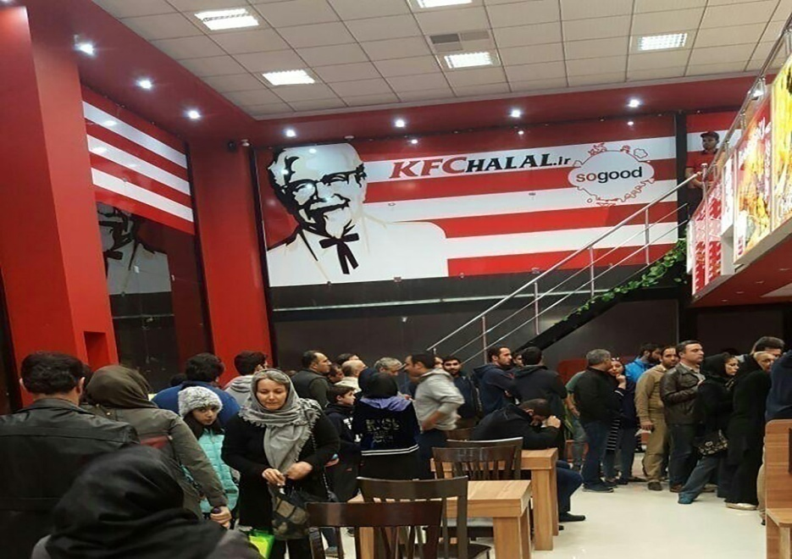

Examples:
Attainment Expedients of Markovian Heterogeneous Water Heaters in Queueing Models
by Matrix Geometric Method
Wait to eat at restaurants.
Wait to line at grocery shops to check-out.
Wait in beauty parlours or barber shops.

Slide 25
Attainment Expedients of Markovian Heterogeneous Water Heaters in Queueing Models
by Matrix Geometric Method
Components of a Basic Queuing Process
The Queuing System
Input Source
Served customers
Calling Population
customers
Service Mechanism
Queue
Queue
leave the system
Arrival Process
Queue Discipline
Service Process
Queue Configuration

Slide 26
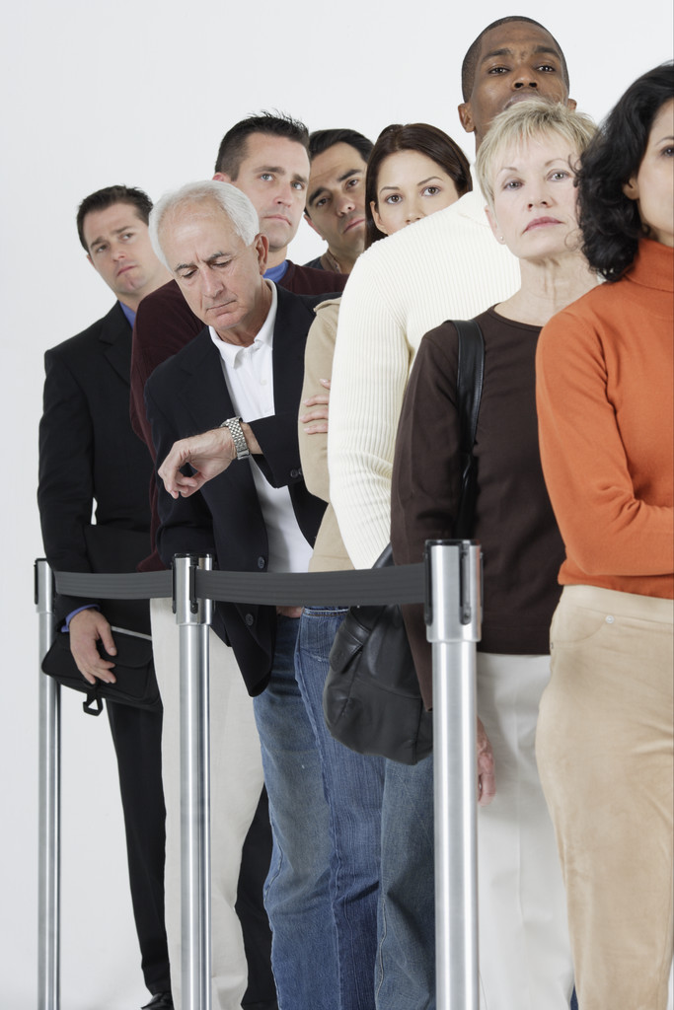
Attainment Expedients of Markovian Heterogeneous Water Heaters in Queueing Models
by Matrix Geometric Method
Queueing system
A queueing system can be described as customers arriving for service, waiting for service if it is not immediate, and if having waited for service, leaving the system after being served.

Slide 27
Attainment Expedients of Markovian Heterogeneous Water Heaters in Queueing Models
by Matrix Geometric Method
Arrival pattern of customers:
The arrival pattern of customers refers the manner in which the arrival occur.
It is specified by the inter arrival time between any two consecutive arrivals.
The customer may arrive singly or batches.

Slide 28
Attainment Expedients of Markovian Heterogeneous Water Heaters in Queueing Models
by Matrix Geometric Method
Single Arrival
Poisson Process with Rate l
Inter-arrival times are independent and exponentially distributed.
The average inter-arrival time is 1/ l

Slide 29
Attainment Expedients of Markovian Heterogeneous Water Heaters in Queueing Models
by Matrix Geometric Method
Batch Arrivals
Some sources transmit in packet bursts may be better modeled by a batch arrival process
e.g., bursts of packets arriving according to a Poisson process

Slide 30
Components of a Basic Queuing Process (III)
Attainment Expedients of Markovian Heterogeneous Water Heaters in Queueing Models
by Matrix Geometric Method
The queue configuration
  Specifies the number of queues
    Single or multiple lines to a number of service stations
    Their effect on customer behavior
    Balking , reneging and Jockeying

Slide 31
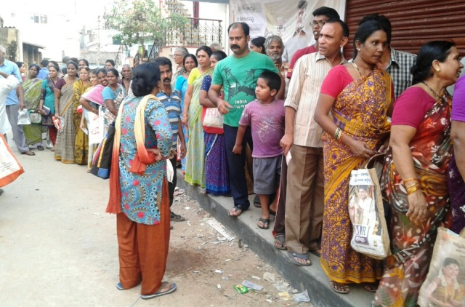
Attainment Expedients of Markovian Heterogeneous Water Heaters in Queueing Models
by Matrix Geometric Method
Balking
The arriving customer saw the queue is too long
.
If the customer decide not to enter the queue upon arrival is called balking.

Slide 32
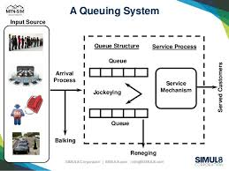

Attainment Expedients of Markovian Heterogeneous Water Heaters in Queueing Models
by Matrix Geometric Method
Reneging Customers
A customer may enter the queue, but after he may decide to leaving due to impatience is reneged.

Slide 33
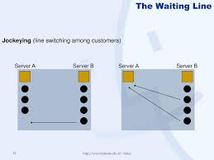
Attainment Expedients of Markovian Heterogeneous Water Heaters in Queueing Models
by Matrix Geometric Method
Jockeying
If there are two or more parallel channel, customers switch from one queue to another queue for some reasons is called jockeying.

Slide 34
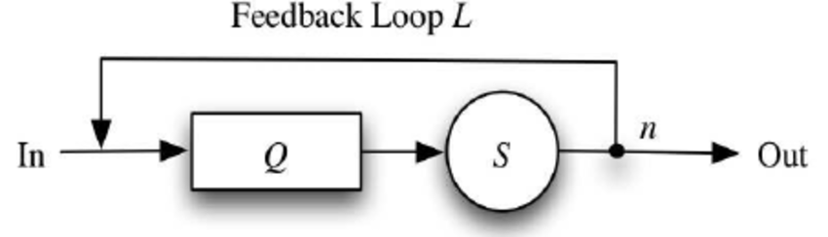
Attainment Expedients of Markovian Heterogeneous Water Heaters in Queueing Models
by Matrix Geometric Method
Feedback queueing system
After service completion, the customer may under some decision rule, independent of the remaining stochastic behaviour of the system, return to the waiting line to receive another service

Slide 35
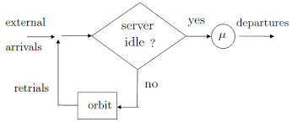
In the queueing System, if customers arrive for service and find all servers accessible to them are busy, leave the service area temporarily, stay in orbit and repeat their demand after some random period of time
Attainment Expedients of Markovian Heterogeneous Water Heaters in Queueing Models
by Matrix Geometric Method
Retrial Queue:

Slide 36
Attainment Expedients of Markovian Heterogeneous Water Heaters in Queueing Models
by Matrix Geometric Method
Service pattern:
The service pattern of servers refers the manner in which the service is rendered.
It is specified by the time taken to complete a service.
Service may also in singly or in batches.
The service process may depend on the number of customers waiting for service.

Slide 37
Attainment Expedients of Markovian Heterogeneous Water Heaters in Queueing Models
by Matrix Geometric Method
Two Queue Configurations
Single Queue
Multiple Queues
Servers
Servers

Slide 38
Attainment Expedients of Markovian Heterogeneous Water Heaters in Queueing Models
by Matrix Geometric Method
Queue discipline:
The common queue discipline is First Come First Serve" or it is sometimes called First In First Out" abbreviated as respectively as FCFS or FIFO.
(i) LCFS (or) LIFO
Last come First Serve or Last In First Out
(ii) SIRO- Service In Random Order
(iii) Priority Discipline

Slide 39
Attainment Expedients of Markovian Heterogeneous Water Heaters in Queueing Models
by Matrix Geometric Method
Single Server Queueing system

Slide 40
Attainment Expedients of Markovian Heterogeneous Water Heaters in Queueing Models
by Matrix Geometric Method
Multiple Servers
Head of the line service Customers wait in a queue, and when a server becomes free, the first customer goes into service

Slide 41

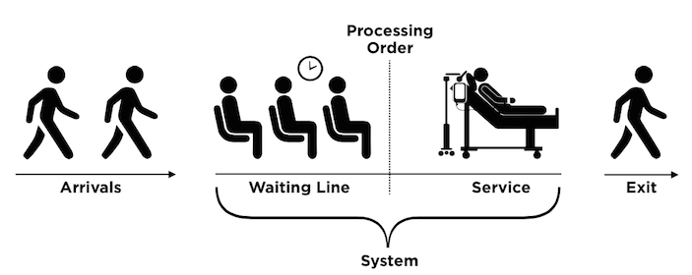
Attainment Expedients of Markovian Heterogeneous Water Heaters in Queueing Models
by Matrix Geometric Method
Customer Behaviours
The Waiting Time:
The waiting time in queue refers the time spent by a customer in waiting before service.
The waiting time in system is the waiting time
(before service) plus service time.

Slide 42
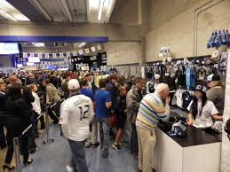
Attainment Expedients of Markovian Heterogeneous Water Heaters in Queueing Models
by Matrix Geometric Method
Server Behaviours
Busy Period :
A busy period starts with an arrival at an empty service facility and ends when the number of customers in the system drops to zero for the first time and then an idle period starts which ends at the commencement of the next busy period

Slide 43

Attainment Expedients of Markovian Heterogeneous Water Heaters in Queueing Models
by Matrix Geometric Method
Server Behaviours
The Vacation time:
After serving a certain number of customers ruled by a specific service discipline, the server may become unavailable for period of time called vacation time.

Slide 44
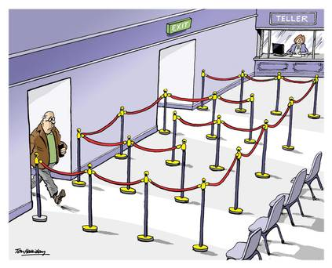
Attainment Expedients of Markovian Heterogeneous Water Heaters in Queueing Models
by Matrix Geometric Method
The Vacation: Setup time
After vacation the server returns for further service.
If the queue is still empty the server takes another vacation otherwise the server needs a setup time and may attend the waiting customers in order.

Slide 45

Attainment Expedients of Markovian Heterogeneous Water Heaters in Queueing Models
by Matrix Geometric Method
Server Behaviours
The Working Vacation:
During the vacation period, if there are customers waiting for service, the server may served the customers with lower rate of service rather than completely stopping the service.

Slide 46
During working vacation period, if there is no customer in the system, the server takes another vacation.
Attainment Expedients of Markovian Heterogeneous Water Heaters in Queueing Models
by Matrix Geometric Method
Server Behaviours
Multiple Working Vacation
Vacation interruption:
The server stop the vacation, if the number of waiting customers, achieving a certain value during the vacation.

Slide 47


Attainment Expedients of Markovian Heterogeneous Water Heaters in Queueing Models
by Matrix Geometric Method
Server breakdown
A Queueing system might suddenly breakdown and hence the server will not be able to continue providing service unless the system is repaired.

Slide 48

Attainment Expedients of Markovian Heterogeneous Water Heaters in Queueing Models
by Matrix Geometric Method
Heterogeneous server
The service time distributions may be different for different servers.

Slide 49
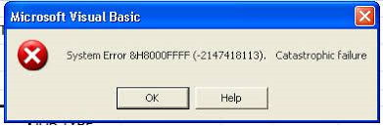
Attainment Expedients of Markovian Heterogeneous Water Heaters in Queueing Models
by Matrix Geometric Method
CATASTROPIC QUEUEING SYTEM
When occurrence of a catastrophe all the customers in the system is destroyed immediately

Slide 50
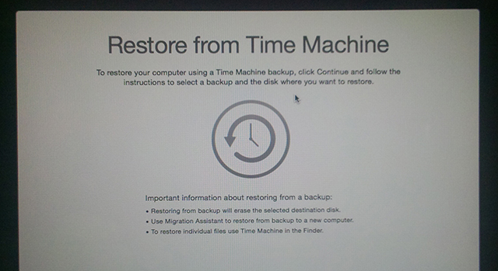
Attainment Expedients of Markovian Heterogeneous Water Heaters in Queueing Models
by Matrix Geometric Method
Restoration Time
The system takes its own time to be ready to accept new customers, this time is referred to as ‘the restoration time’ .

Slide 51
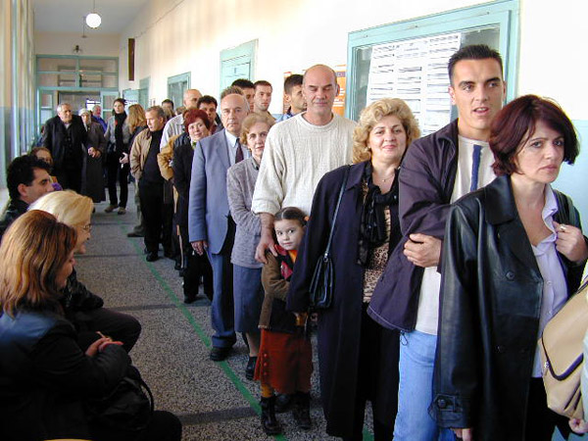
Attainment Expedients of Markovian Heterogeneous Water Heaters in Queueing Models
by Matrix Geometric Method
The System Capacity:
In some queueing processes there is a physical limitation to the amount of waiting space, so that when the line reaches a certain length, no further customers are allowed to enter until space completion.
These are referred to as finite queueing system.
Otherwise the process is a infinite queueing system.

Slide 52
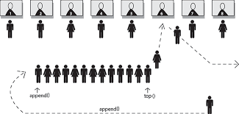
Attainment Expedients of Markovian Heterogeneous Water Heaters in Queueing Models
by Matrix Geometric Method
Number of Service Channels:
The system may have a single channel or a number of parallel channels for service.
.

Slide 53
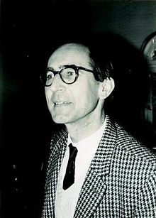
Notations
Attainment Expedients of Markovian Heterogeneous Water Heaters in Queueing Models
by Matrix Geometric Method
The notation introduced by Kendall (1953).
A queueing model is described by a series of symbols and slashes such as A/B/X/Y/Z
A - the inter-arrival time distribution .
B - the service time distribution.
X - the number of parallel channels.
Y - the system capacity .
Z - the queue discipline.
D.G. Kendall

Slide 54
Little’s Formula
Attainment Expedients of Markovian Heterogeneous Water Heaters in Queueing Models
by Matrix Geometric Method
Assume that λ_{n} = λ and μ_{n} = μ for all n
Assume that λ_{n} is dependent on n

Slide 55
Attainment Expedients of Markovian Heterogeneous Water Heaters in Queueing Models
by Matrix Geometric Method
Birth-and-Death Processes
The most commonly used queuing models
  Birth – equivalent to the arrival of a customer
  Death – equivalent to the departure of a served customer
Assumptions
Given N(t)=n,
  The time until the next birth (T_{B}) is exponentially distributed with parameter λ_{n}
  (Customers arrive according to a Poisson process)
  The remaining service time (T_{D}) is exponentially distributed with parameter μ_{n}
T_{B} & T_{D} are mutually independent stochastic variables
exactly one Birth (n → n+1) or one Death (n → n–1)

Slide 56
A Birth-and-Death Process Rate Diagram
Attainment Expedients of Markovian Heterogeneous Water Heaters in Queueing Models
by Matrix Geometric Method
Excellent tool for describing the mechanics of a
Birth-and-Death process
λ₀
λ₁
λ_{n-1}
λ_{n}
0
1
2
n-1
n
n+1
μ₁
μ₂
μ_{n}
μ_{n+1}
n
= State n, i.e., the case of n customers in the system

Slide 57
Attainment Expedients of Markovian Heterogeneous Water Heaters in Queueing Models
by Matrix Geometric Method
Heat conduction

Slide 58
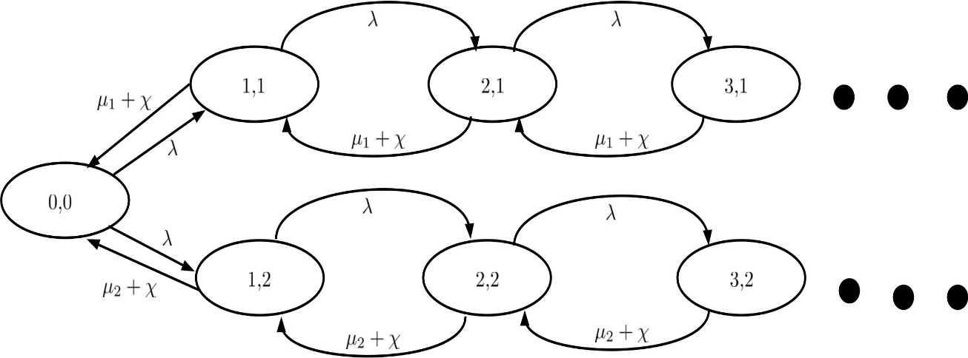
Transition Diagram
Attainment Expedients of Markovian Heterogeneous Water Heaters in Queueing Models
by Matrix Geometric Method

Slide 59
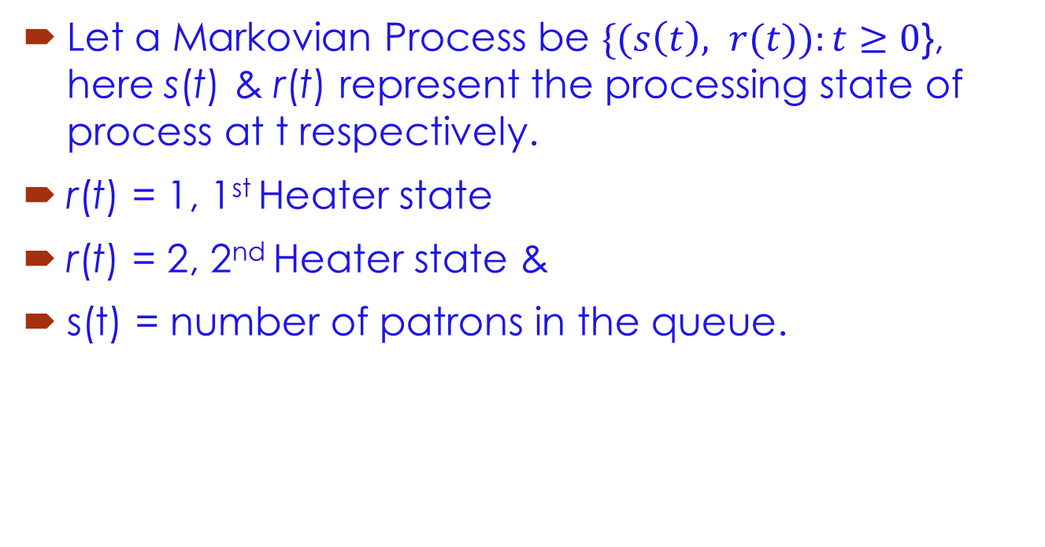
Attainment Expedients of Markovian Heterogeneous Water Heaters in Queueing Models
by Matrix Geometric Method
Let a Markovian Process be $\{(s\left(t\right), r(t)):t≥0$}, here s(t) & r(t) represent the processing state of process at t respectively.
r(t) = 1, 1st Heater state
r(t) = 2, 2nd Heater state &
s(t) = number of patrons in the queue.

Slide 60
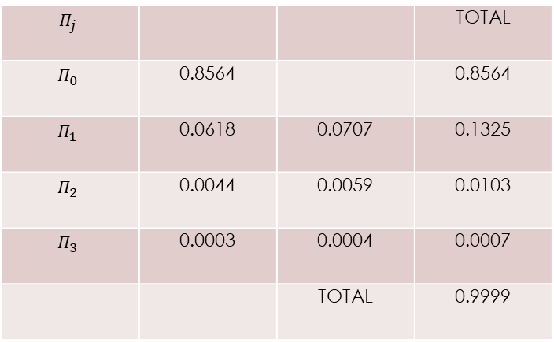
We take λ = 0.05, µ₁ = 0.5, µ₂ = 0.4, =0.2, R=0.0714 0 0 0.0833
Table 1: Probability Vector
Attainment Expedients of Markovian Heterogeneous Water Heaters in Queueing Models
by Matrix Geometric Method
Mathematical Study
Case (i)
$$Π_{j}$$ |  |  | TOTAL
$$Π_{0}$$ | 0.8564 |  | 0.8564
$$Π_{1}$$ | 0.0618 | 0.0707 | 0.1325
$$Π_{2}$$ | 0.0044 | 0.0059 | 0.0103
$$Π_{3}$$ | 0.0003 | 0.0004 | 0.0007
 |  | TOTAL | 0.9999

Slide 61
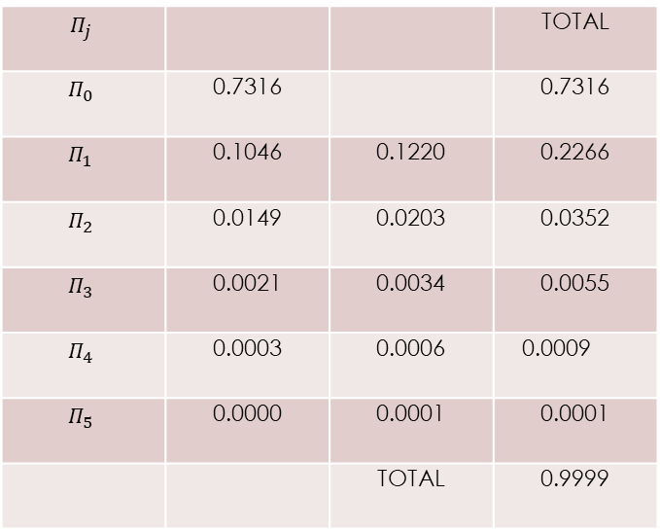
If λ = 0.1, µ₁ = 0.5, µ₂ = 0.4, =0.2, R=0.1429 0 0 0.1667
Table 2: Probability Vector
Attainment Expedients of Markovian Heterogeneous Water Heaters in Queueing Models
by Matrix Geometric Method
Case (ii)
$$Π_{j}$$ |  |  | TOTAL
$$Π_{0}$$ | 0.7316 |  | 0.7316
$$Π_{1}$$ | 0.1046 | 0.1220 | 0.2266
$$Π_{2}$$ | 0.0149 | 0.0203 | 0.0352
$$Π_{3}$$ | 0.0021 | 0.0034 | 0.0055
$$Π_{4}$$ | 0.0003 | 0.0006 | 0.0009
$$Π_{5}$$ | 0.0000 | 0.0001 | 0.0001
 |  | TOTAL | 0.9999

Slide 62
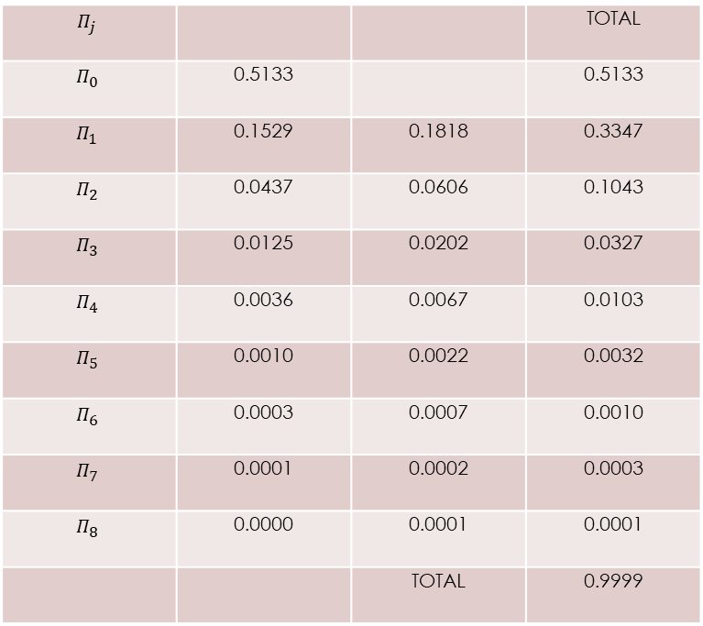
If λ = 0.2, µ₁ = 0.5, µ₂ = 0.4, =0.2, R=0.2857 0 0 0.3333
Table 3: Probability Vector
Attainment Expedients of Markovian Heterogeneous Water Heaters in Queueing Models
by Matrix Geometric Method
Case (iii)
$$Π_{j}$$ |  |  | TOTAL
$$Π_{0}$$ | 0.5133 |  | 0.5133
$$Π_{1}$$ | 0.1529 | 0.1818 | 0.3347
$$Π_{2}$$ | 0.0437 | 0.0606 | 0.1043
$$Π_{3}$$ | 0.0125 | 0.0202 | 0.0327
$$Π_{4}$$ | 0.0036 | 0.0067 | 0.0103
$$Π_{5}$$ | 0.0010 | 0.0022 | 0.0032
$$Π_{6}$$ | 0.0003 | 0.0007 | 0.0010
$$Π_{7}$$ | 0.0001 | 0.0002 | 0.0003
$$Π_{8}$$ | 0.0000 | 0.0001 | 0.0001
 |  | TOTAL | 0.9999

Slide 63
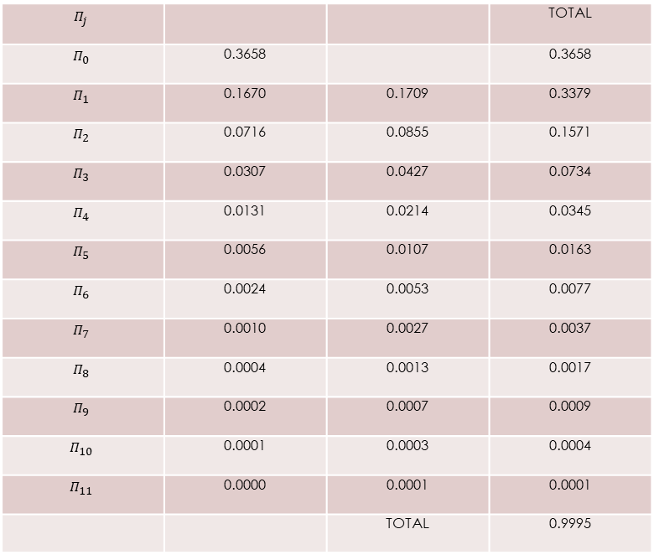

Attainment Expedients of Markovian Heterogeneous Water Heaters in Queueing Models
by Matrix Geometric Method
Case (iv)
If λ= 0.3, µ₁ = 0.5, µ₂ = 0.4, $=0.2$, $R=\left(0.2857 0 0 0.3333 \right)$
Table 4: Probability Vector
$$Π_{j}$$ |  |  | TOTAL
$$Π_{0}$$ | 0.3658 |  | 0.3658
$$Π_{1}$$ | 0.1670 | 0.1709 | 0.3379
$$Π_{2}$$ | 0.0716 | 0.0855 | 0.1571
$$Π_{3}$$ | 0.0307 | 0.0427 | 0.0734
$$Π_{4}$$ | 0.0131 | 0.0214 | 0.0345
$$Π_{5}$$ | 0.0056 | 0.0107 | 0.0163
$$Π_{6}$$ | 0.0024 | 0.0053 | 0.0077
$$Π_{7}$$ | 0.0010 | 0.0027 | 0.0037
$$Π_{8}$$ | 0.0004 | 0.0013 | 0.0017
$$Π_{9}$$ | 0.0002 | 0.0007 | 0.0009
$$Π_{10}$$ | 0.0001 | 0.0003 | 0.0004
$$Π_{11}$$ | 0.0000 | 0.0001 | 0.0001
 |  | TOTAL | 0.9995

Slide 64
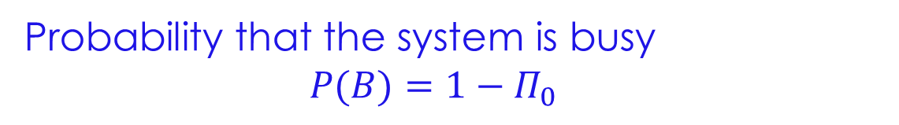
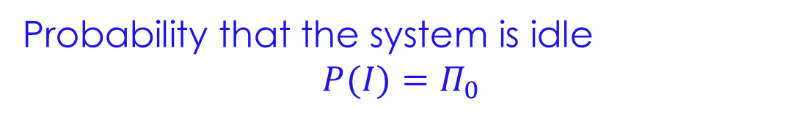
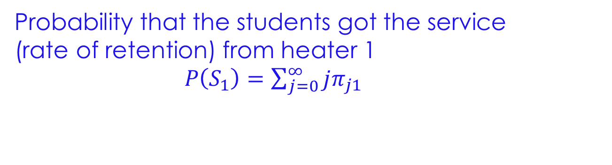
Attainment Expedients of Markovian Heterogeneous Water Heaters in Queueing Models
by Matrix Geometric Method
Performance Measures
Probability that the system is idle
$$P(I)=Π_{0}$$
Probability that the system is busy
$$P(B)={1−Π}_{0}$$
Probability that the students got the service
(rate of retention) from heater 1
$P\left(S_{1}\right)=\sum_{j=0}^{∞}{jπ_{j1}}$

Slide 65
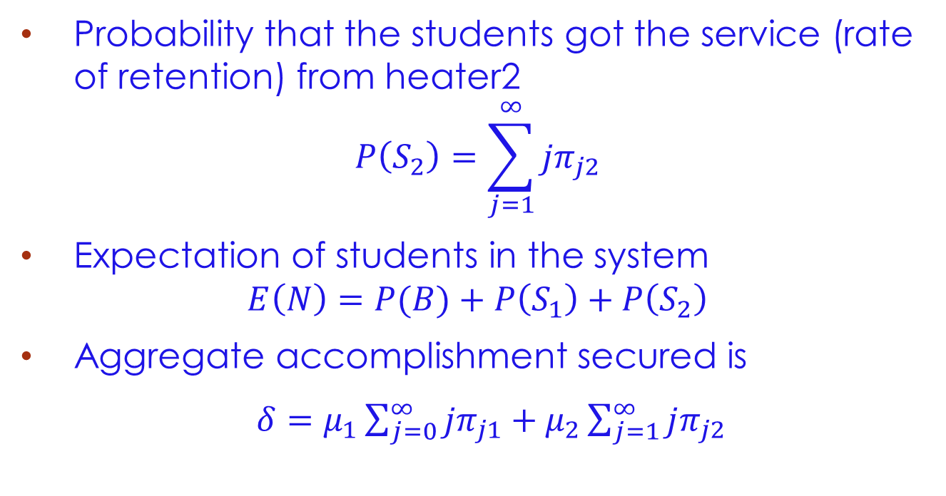
Attainment Expedients of Markovian Heterogeneous Water Heaters in Queueing Models
by Matrix Geometric Method
Probability that the students got the service (rate of retention) from heater2
$$P\left(S_{2}\right)=\sum_{j=1}^{∞}{jπ_{j2}}$$
Expectation of students in the system
$$E\left(N\right)=P(B)+P\left(S_{1}\right)+P\left(S_{2}\right)$$
Aggregate accomplishment secured is
$δ=μ_{1}\sum_{j=0}^{∞}{jπ_{j1}}+μ_{2}\sum_{j=1}^{∞}{jπ_{j2} }$

Slide 66
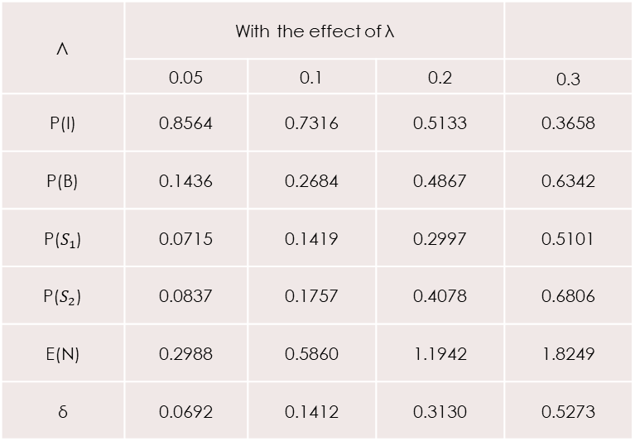
Performance Measures with the effect of λ
Attainment Expedients of Markovian Heterogeneous Water Heaters in Queueing Models
by Matrix Geometric Method
Λ | With the effect of λ
 | 0.05 | 0.1 | 0.2 | 0.3
P(I) | 0.8564 | 0.7316 | 0.5133 | 0.3658
P(B) | 0.1436 | 0.2684 | 0.4867 | 0.6342
P($S_{1}$) | 0.0715 | 0.1419 | 0.2997 | 0.5101
P($S_{2}$) | 0.0837 | 0.1757 | 0.4078 | 0.6806
E(N) | 0.2988 | 0.5860 | 1.1942 | 1.8249
δ | 0.0692 | 0.1412 | 0.3130 | 0.5273

Slide 67
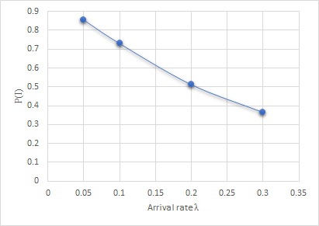
Arrival versus P(I)
Attainment Expedients of Markovian Heterogeneous Water Heaters in Queueing Models
by Matrix Geometric Method

Slide 68
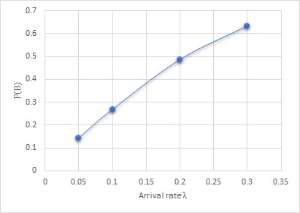
Arrival versus P(B)
Attainment Expedients of Markovian Heterogeneous Water Heaters in Queueing Models
by Matrix Geometric Method

Slide 69
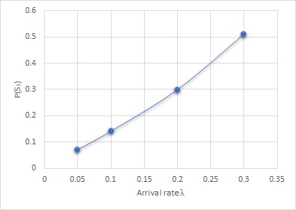
Arrival versus P(S₁)
Attainment Expedients of Markovian Heterogeneous Water Heaters in Queueing Models
by Matrix Geometric Method

Slide 70
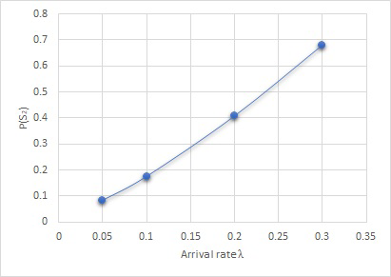
Arrival versus P(S₂)
Attainment Expedients of Markovian Heterogeneous Water Heaters in Queueing Models
by Matrix Geometric Method

Slide 71
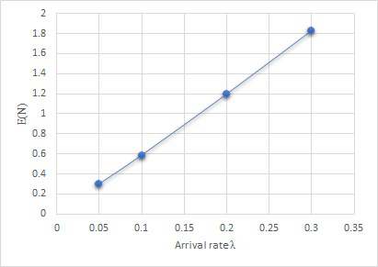
Arrival versus E(N)
Attainment Expedients of Markovian Heterogeneous Water Heaters in Queueing Models
by Matrix Geometric Method

Slide 72
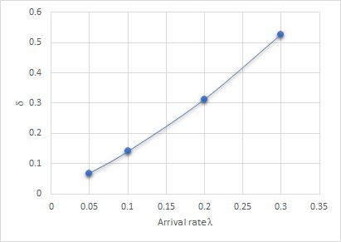

Arrival versus $δ$
Attainment Expedients of Markovian Heterogeneous Water Heaters in Queueing Models
by Matrix Geometric Method

Slide 73
Attainment Expedients of Markovian Heterogeneous Water Heaters in Queueing Models
by Matrix Geometric Method
Out of the above figures, if the arrival rate increases then the probability of the system are idle decreases.
And if the arrival rate increases then the probability of the system is busy, students got the service from heater 1, and students got the service from heater 2, expectation of students throughout the system & aggregate accomplishment secured increases.

Slide 74
References
Attainment Expedients of Markovian Heterogeneous Water Heaters in Queueing Models
by Matrix Geometric Method
D.G. Kendall, Stochastic Process occurring in this Theory of Queues and their analysis by the method of Markov Chain.
J. Medhi., Stochastic Processes, Third Edition. New age International Publishers.
P. Kandasamy et al., Probability and Queueing theory, S. Chand Publishers.

Slide 75



